Slide 1
IOT

Slide 2
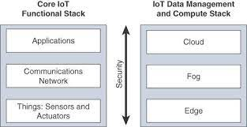
Core IOT Functional Stack Applications
IOT Network management sublayer
At this layer several applications that process,analyse,visualize, control,manage and report the collected data from “things”
Some applications could only control manage IOT based systems
Some applications could synthesize the collected information and generate meaningful reports and actionable insights

Slide 3
Application and Analytics layer
It is composed of many applications.
These applications can process, analyse, visualize, control, manage & report the collected data from “things”.
Application can be developed as per user requirement.
Some applications are just for control, manage and operate the IOT systems.
Some applications can synthesis the collected information and generate meaningful reports & actionable heights.

Slide 4
Analytics Application
This type of application collects data from multiple smart objects, processes the collected data.
It displays information resulting from the data processed.
It always processes the data received from the multiple smart objects and then convey to the Network.
The information is presented in such a way we can take meaningful actions.

Slide 5
Control Application
These applications control the behaviour of the smart object.
These applications are very useful for controlling complex aspects of an IOT network.
Ex- Pressure sensor may be connected to a pump. A control application increases the pump speed when the connected sensor detect a drop in pressure.
Ex- control application automatically turns off the light is the illumination level of an area is sufficiently good.

Slide 6
Advanced Application Module
Advanced application module may include both analytics and control module.
Data is collected from the smart objects & processed in the analytics module.
The result of the processing module may be used by control module.
Control module modify the behaviour of the smart objects and system related to the smart objects.
Control module also conveys the instructions for the behavioural changes.

Slide 7
Data Analytics
It is meant to process the data collected by smart objects combine it to provide an intelligent view related to the IOT system.
Data processing can be very complex and may have complex Algorithm.
Data processing can be done for one smart object (IOT Thing)
Ex- Dash board can display an alarm when a weight sensor detects that a
sheet is empty in a store.
Data processing can be complex involving multiple sensor or IOT devices.
Ex- Temperature, pressure, humidity of thousands of sensors is collected and
processed to determine the likelihood of a storm and its probable path.

Slide 8
Network Analytics
Network connectivity between smart objects will affect the efficiency of the system.
Loss of connectivity may result in accident or degradation of operation efficiency.
Network analytics plays import role in connecting all systems.
Basic connectivity may be enough if smart objects report occasional status without expectation for immediate action.
Detailed connectivity required if the central application is expected to pilot in near – real – time connected systems.

Slide 9
IOT Protocols
The open system inter connection model (OSI model) is a conceptual model that characterizes and standardizes the communication functions of Networked communications without diving into complexities of protocols, architecture and the underlying technologies.
OSI Model has (7) seven layers.
Each layer interacts with the layer above and below it and passes on the respective protocol data units.
When data move from top to down layers encapsulation happens.
Encapsulation means the process of adding layer specific information and passing on the data to the next layer below is called encapsulation.
When data move from bottom to top layer, decapsulation happens.
Decapsulation means the process of removing layer specific information and passing on the data to the next layer above is called decapsulation.

Slide 10
Link layer protocols
802.3 Ethernet
802.11 WCAN
802.15.4 – LR – WPAN
802.16 Wi MAX
2G/ 3G / 4G /LTE / 5G Cellular

Slide 11
802.3 Ethernet
It is developed by IEEE for wired Ethernet technology.
802.3a, 802.3i, 802.3j, 802.3ae, 802.3z these all come under same umbrella.
Each of these will have its even set of detailed specifications.
They can use STAR or BUS Topology.
Connecting devices used are coaxial cables twisted pairs and optical fibres.
Speed could be 10Mbps to 10Gbps.

Slide 12
802.11 WLAN
It is developed by IEEE for WLAN.
802.11a, 802.11b, 802.11g, 802.11n, 802.11i these all come under same umbrella.
Each of these will have its own set of detailed specifications.
WLAN is usually implemented as Wi-fi most preferred way to connect devices.
It provides roaming capabilities and do not require any external interface.
It also helps to reduce the size of IOT devices.

Slide 13
802.15.4 LR-WPAN
It is developed by IEEE or LR-WPAN.
802.15.4A, 802.15.4c, 802.15.4d, 802.15.4e, 802.15.4f all these come under same umbrella.
This protocol is low power consumption, low data rate, low cost and high message throughout.
It provides 250kbps, 40kbps and 20 kbps.
It can handle huge IOT devices.

Slide 14
802.16 Wi MAX
It is developed by IEEE for broadband wireless Metropolitan Area Network Technology.
802.16.1a, 802.16.1b, 802.16p, 802.16n, 802.16a, will come under same umbrella.
All will have their own detailed specifications.
802.16 officially called as wireless MAN.
802.16 commercialized under the name
“Wi MAX” (World Wide interoperability for Microwave Access)
It provides data rate 1.5 Mbps to 1 Gbps.

Slide 15
2G/ 3G / 4G /LTE /5G - Cellular
Cellular Networks are used for data connectivity as well as voice connectivity.
Analog circuit – 1G
GSM – 2G
UMTS – 3G
LTE – 4G
5G New Radio – 5G

Slide 16
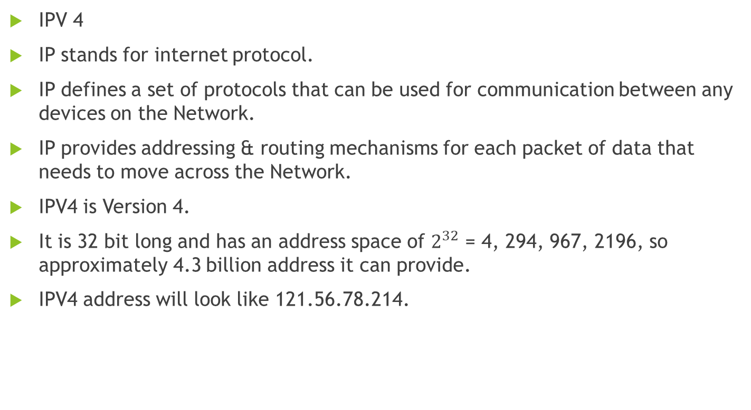
Network layer Protocol
IPV 4
IP stands for internet protocol.
IP defines a set of protocols that can be used for communication between any devices on the Network.
IP provides addressing & routing mechanisms for each packet of data that needs to move across the Network.
IPV4 is Version 4.
It is 32 bit long and has an address space of $2^{32}$ = 4, 294, 967, 2196, so approximately 4.3 billion address it can provide.
IPV4 address will look like 121.56.78.214.

Slide 17
IPv6
IPv6 IS IP version 6
IPv6 address is 128 bit long, so we can have 128 addresses.
IPv6 is able to provide enough IP addresses to cover entire spectrum of IOT devices.
IPv6 address looks like 2001:0:gd38: 6abd: 2c37:10da:

Slide 18
Transport layer Protocol (TCP)
Transmission control Protocol
It helps to establish & maintain Network through which application program can exchange data.
It is reliable and connection oriented protocol.
It ensures packets are delivered to the destination host.
If the packets are lost during transmission, then TCP has the ability to identify this issue and resend the lost or compted packet.
TCP also supports packet sequencing, Congestion Control and error detection and correction.

Slide 19
Transport Layer Protocol (UDP)
It provides procedure for application programs to send messages to other program with minimum resources.
It is connection less protocol.
It has neither packet sequencing nor flow and congestion control.
There is no acknowledgement after delivering the packet.
It does not guarantee that a packet will reach its destination.
Hence it is unreliable protocol.
But it is faster than TCP and require less resources.

Slide 20
Application layer Protocols
HTTP
Hypertext Transfer Protocol used to transfer data on distributed and connects systems.
HTTP is state less protocol.
It means that client & web server make and break a connection for each interaction.
When user request to view a web page that the web server finds the requested web page, present to the user and then terminates the connection.

Slide 21
Application layer Protocol
HTTPS
It is the secure version of HTTP
S stands for secure.
All the communication between client and server will be secured.
HTTPS usually used to protect confidential online interactions such as online banking.
HTTPS keep client & server connections established until it is terminated.

Slide 22
CoAP
Constrained Application Protocol.
It is specialized web transfer protocol.
It is used for low power, low processing capabilities.
It is also constrained for low rate networks.
This protocol is specially designed for M2M applications such as smart energy & building automation.

